Slide 1
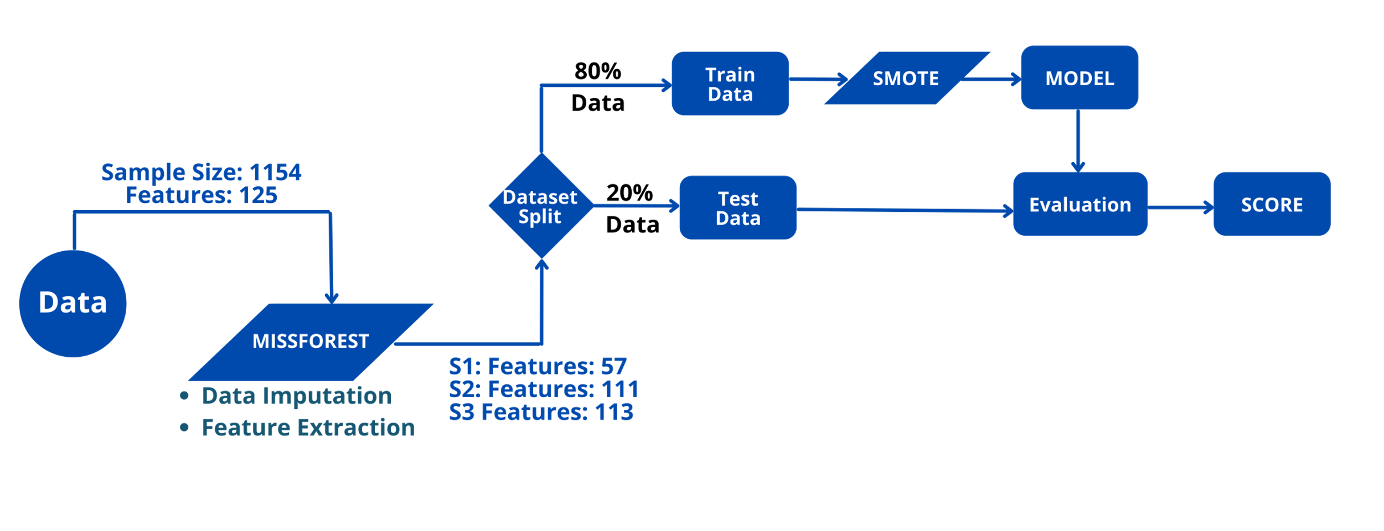
Predicting Developmental Delay in Very Pre-Term Infants Using Machine Learning
Demirci G.M.¹, Tsai C.², Flory M.³, Phan H.^{3,4}, Gordon A.^{3,4}, Parab S.⁴, Kittler P.^{3,4}
¹CUNY Graduate Center, ²CUNY Queens College, ³NYS Institute for Basic Research in Developmental Disabilities, ⁴Richmond University Medical Center
INTRODUCTION
We applied machine learning (ML) to predict neurodevelopmental outcomes in pre-term infants (<34 wks gestational age) using a retrospective sample of 1154 NICU infants.
In this high-risk group, the earlier that infants who will be delayed can be identified, the earlier interventions can be initiated and the better the overall outcome.
Our aim was to predict delay (score <85) at 25 months on the Bayley II Psychomotor and Mental scales by using Random Forest Classifier algorithm, and to compare ML predictions relying only on at-birth variables to those including subsequent infant assessments.
METHOD
RESULTS
To test the accuracy of the model, we used a small set of data that the model had never seen. We split the dataset 80/20, and 80% of the dataset was trained by the model while 20% of it was tested.
Our application of ML techniques produced predictions with high specificity/few false alarms and low selectivity/many misses.
CONCLUSIONS
The ML model accuracy improves with the inclusion of assessments closer to the outcome, i.e. the 24 mo Bayley scores.
The high specificity of these models suggests some use, through elimination, by casting a narrower net in identifying those infants needing vigilant follow-up.
In the future, the precision of ML for predicting neurodevelopmental outcomes might be improved by including additional variables available at birth, such as socio-economic status, that influence development via environmental interactions.
CONTACT
Gozde Demirci gdemirci1@gradcenter.cuny.edu
Phyllis Kittler phyllis.kittler@opwdd.ny.gov
TOP 10 FEATURES
MENTAL DELAY | PSYCHOMOTOR DELAY
birth weight | birth weight
estimated gestational age | estimated gestational age
head circumference | head circumference
days in hospital | 5 min apgar score
mom's education | 10 min apgar score
number of pregnancies | days in hospital
pregnancies carried past 20 weeks | mom's age
antenatal steroids | mom's education
days on CPAP | small for gestational age
abnormal cranial ultrasound | days on CPAP
ACCURACY OF MODELS | ACCURACY OF MODELS
PSYCHOMOTOR DEVELOPMENT ACCURACY SCORES | PSYCHOMOTOR DEVELOPMENT SCORE
Scenarios | Sensitivity | Specificity | PPV | NPV
Scenario 1 | 0.583 | 0.879 | 0.359 | 0.948
Scenario 2 | 0.429 | 0.936 | 0.48 | 0.922
Scenario 3 | 0.593 | 0.931 | 0.533 | 0.945
Training on 80% of data to develop Models (3 Scenarios)
MENTAL DEVELOPMENT ACCURACY SCORES | MENTAL DEVELOPMENT ACCURACY SCORES
Scenarios | Sensitivity | Specificity | PPV | NPV
Scenario 1 | 0.368 | 0.929 | 0.318 | 0.942
Scenario 2 | 0.556 | 0.934 | 0.417 | 0.961
Scenario 3 | 0.412 | 0.962 | 0.467 | 0.953
PPV: positive predictive value; NPV: negative predictive value
Test Model Accuracy Using 20 % of Data
A common challenge for longitudinal studies is missing data. We applied MissForest, a non-parametric missing value imputation technique based on Random Forest to handle missing parameters. Also, the Synthetic Minority Oversampling Technique (SMOTE) was applied to create augmented data for the minority (delayed) class.
Use ML to Develop Models for 3 Scenarios
 | Training set (# samples: 954) |  |  | Test set (# samples: 200)
 | missing ratio | SMOTE | MissForest | missing ratio | SMOTE | MissForest
target value | 0.96 | YES | YES | 0.00 | NO | NO
predictors | 0.12 | YES | YES | 0.11 | NO | YES
Predictor Information for Each Scenario
Scenarios | At-birth Variables N=57 | Month 00 RNNA N=26 | Month 01 RNNA N=28 | Month 16 Bayley Test N=2 | Total Variables
1 | X |  |  |  | 57
2 | X | X | X |  | 111
3 | X | X | X | X | 113
RNNA: Rapid Neonatal Neurobehavioral Assessment
Presented at 2022 Association for Psychological Science (APS) Annual Convention, Chicago, IL, May 26-29, 2022 This work was supported in part by funds from CUNY Graduate Center and NYS OPWDD/Institute for Basic Research
Notes:
Given data has missing values on both predictors and the target values (mental & motor Bayley Scale at month 25).

